Slide 1
Tasks

Slide 2
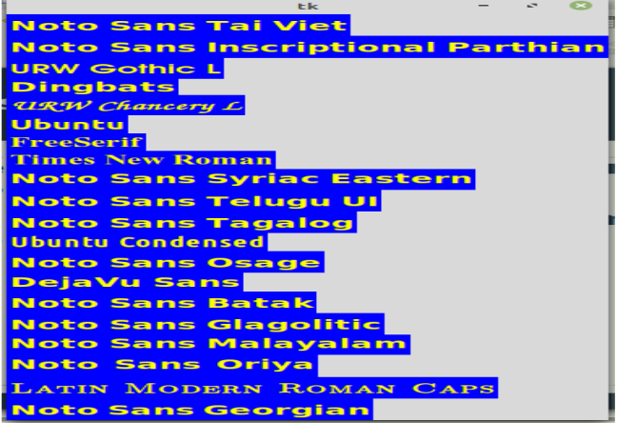
Text
Read fonts in a window like the image below.

Slide 3
Video
Read the first 50 seconds from a video then rotate the video by 90 degree then save it as an mp4 to your pc(using moviepy).

